Slide 1
Topic: Linear Algebra EQ: Do Parallel lines have specific properties associated with their gradients.?

Slide 2
Contents
Glossary or Formula Page
Page
Date
Description
2
3

Slide 3
Tasks
24
7
30
Essential Question
Questions
Notes
Summary
4
5

Slide 4
24
7
30
Date
Linear Algebra
EQ: Do Parallel lines have specific properties associated with their gradients.?
What are Parallel line?
5

Slide 5
24
7
30
Date
Linear Algebra
EQ: Do Parallel lines have specific properties associated with their gradients.?
What are Parallel line?
Lines that are parallel to each other will never intersect because they have the same slope or gradient.
5

Slide 6
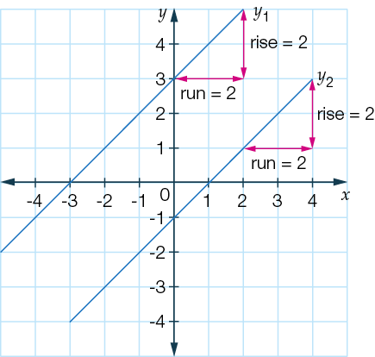
24
7
30
Date
Linear Algebra
EQ: Do Parallel lines have specific properties associated with their gradients.?
What are Parallel line?
Lines that are parallel to each other will never intersect because they have the same slope or gradient.
5

Slide 7
24
7
30
Date
Linear Algebra
EQ: Do Parallel lines have specific properties associated with their gradients.?
What are Parallel line?
Lines that are parallel to each other will never intersect because they have the same slope or gradient.
In the graph shown, we can see that the rise and run of both lines is identical. Hence, they both have the same gradient, which in this case is 1.
5

Slide 8
24
7
30
Date
Linear Algebra
EQ: Do Parallel lines have specific properties associated with their gradients.?
What are Parallel line?
Lines that are parallel to each other will never intersect because they have the same slope or gradient.
In the graph shown, we can see that the rise and run of both lines is identical. Hence, they both have the same gradient, which in this case is 1.
Gradient of y1 = rise = 2 = 1 and y-intercept = 3
run 2
5

Slide 9
24
7
30
Date
Linear Algebra
EQ: Do Parallel lines have specific properties associated with their gradients.?
What are Parallel line?
Lines that are parallel to each other will never intersect because they have the same slope or gradient.
In the graph shown, we can see that the rise and run of both lines is identical. Hence, they both have the same gradient, which in this case is 1.
Gradient of y1 = rise = 2 = 1 and y-intercept = 3
run 2
Therefore, the equation is: y1 = x + 3
5

Slide 10
24
7
30
Date
Linear Algebra
EQ: Do Parallel lines have specific properties associated with their gradients.?
What are Parallel line?
Lines that are parallel to each other will never intersect because they have the same slope or gradient.
In the graph shown, we can see that the rise and run of both lines is identical. Hence, they both have the same gradient, which in this case is 1.
Gradient of y1 = rise = 2 = 1 and y-intercept = 3
run 2
Therefore, the equation is: y1 = x + 3
Gradient of y2 = rise = 2 = 1 and y-intercept = -1
run 2
5

Slide 11
24
7
30
Date
Linear Algebra
EQ: Do Parallel lines have specific properties associated with their gradients.?
What are Parallel line?
Lines that are parallel to each other will never intersect because they have the same slope or gradient.
In the graph shown, we can see that the rise and run of both lines is identical. Hence, they both have the same gradient, which in this case is 1.
Gradient of y1 = rise = 2 = 1 and y-intercept = 3
run 2
Therefore, the equation is: y1 = x + 3
Gradient of y2 = rise = 2 = 1 and y-intercept = -1
run 2
Therefore, the equation is: y2 = x − 1
5

Slide 12
24
7
30
Date
Linear Algebra
EQ: Do Parallel lines have specific properties associated with their gradients.?
Two lines that are parallel have the same gradient: m1 = m2.
5

Slide 13
24
7
30
Date
Linear Algebra
EQ: Do Parallel lines have specific properties associated with their gradients.?
Two lines that are parallel have the same gradient: m1 = m2.
Example#1
5

Slide 14
24
7
30
Date
Linear Algebra
EQ: Do Parallel lines have specific properties associated with their gradients.?
Two lines that are parallel have the same gradient: m1 = m2.
Example#1
Show that the line with equation 2y = 4x − 9 is parallel to the line with equation 3y − 6x + 5 = 0.
5

Slide 15
24
7
30
Date
Linear Algebra
EQ: Do Parallel lines have specific properties associated with their gradients.?
Two lines that are parallel have the same gradient: m1 = m2.
Example#1
Show that the line with equation 2y = 4x − 9 is parallel to the line with equation 3y − 6x + 5 = 0.
Step 1: Rearrange both equations using inverse operations to get the equations in the form y = mx + b.
5

Slide 16
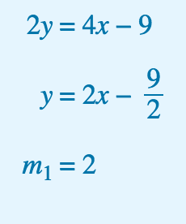
24
7
30
Date
Linear Algebra
EQ: Do Parallel lines have specific properties associated with their gradients.?
Two lines that are parallel have the same gradient: m1 = m2.
Example #1
Show that the line with equation 2y = 4x − 9 is parallel to the line with equation 3y − 6x + 5 = 0.
Step 1: Rearrange both equations using inverse operations to get the equations in the form y = mx + b.
5

Slide 17
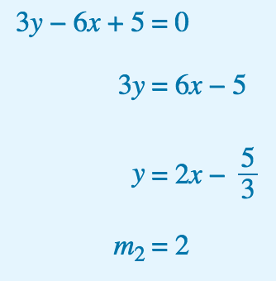
24
7
30
Date
Linear Algebra
EQ: Do Parallel lines have specific properties associated with their gradients.?
Two lines that are parallel have the same gradient: m1 = m2.
Example #1
Show that the line with equation 2y = 4x − 9 is parallel to the line with equation 3y − 6x + 5 = 0.
Step 1: Rearrange both equations using inverse operations to get the equations in the form y = mx + b.
5

Slide 18
24
7
30
Date
Linear Algebra
EQ: Do Parallel lines have specific properties associated with their gradients.?
Two lines that are parallel have the same gradient: m1 = m2.
Example #1
Show that the line with equation 2y = 4x − 9 is parallel to the line with equation 3y − 6x + 5 = 0.
Step 1: Rearrange both equations using inverse operations to get the equations in the form y = mx + b.
Step 2: Compare the gradient values to show that m1 = m2.
5

Slide 19
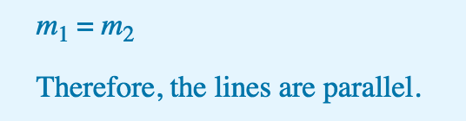
24
7
30
Date
Linear Algebra
EQ: Do Parallel lines have specific properties associated with their gradients.?
Two lines that are parallel have the same gradient: m1 = m2.
Example #1
Show that the line with equation 2y = 4x − 9 is parallel to the line with equation 3y − 6x + 5 = 0.
Step 1: Rearrange both equations using inverse operations to get the equations in the form y = mx + b.
Step 2: Compare the gradient values to show that m1 = m2.
5

Slide 20
Notes Review
24, 7 ,30
Date
Title
Essential question
Notes complete
Notes complete with colour and diagrams
Questions completed
Contents page filed in
Formula page filled in

Slide 21
Homework
Review your notes and write a summary answering the essential question.

